Slide 1
New Zealand Airbnb dataset
Prepared by: Murtadha

Slide 2
Problem statement
43.0% of homes/apartments are available for 250 days of the next year. This leads to a low or negative revenue which leaves the owner barely any profit or no profit at all.

Slide 3
objectives
I will call homes/apts that are available for 250 days of the next year “high availability homes/apts”.
1. What is the median price for the homes/apts and what is the percentage of high availability homes/apts that are above the median?
2. What is the average reviews score of high availability homes/apts compared to the average reviews score for all homes/apt?
3. What is the percentage of high availability homes/apts for each region?

Slide 4
Recommendation
1. Only 50.9% of high availability homes/apts are above the median so the price dose not effect availability that much.
2. The average review score of high availability homes/apts is 4.82 and the average review score for all homes/apts is 4.85. The difference is not large so the review score do not effect availability.
3. Rent home/apts in regions with lower high availability homes/apts percentage.

Slide 5
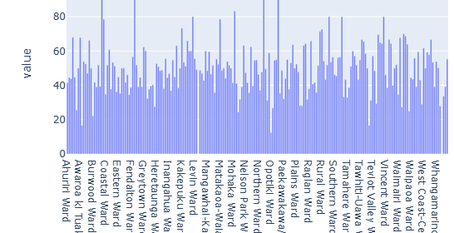

Slide 6
Limitations
Missing prices and reviews for some homes\apts.
There is a columns called neighbourhood with all of it values missing which could have been better than region.

